Slide 1
SCTP
(Stream Control Transmission Protocol)
Sudipta Sarkar
Roll 338

Slide 2

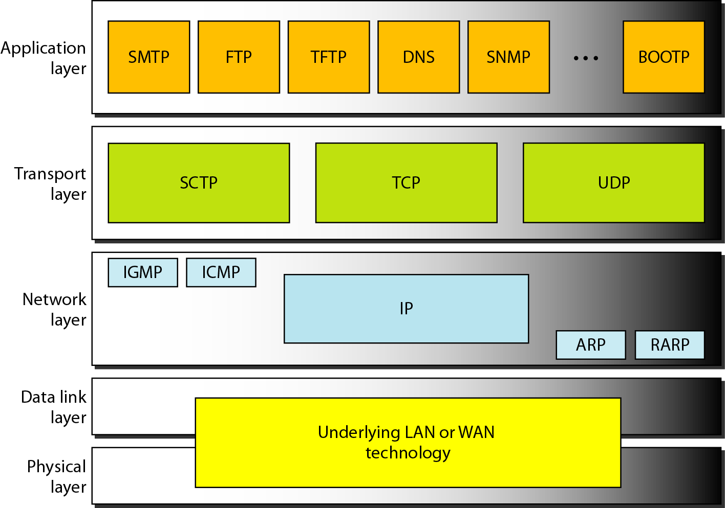
Recap
The transport layer is located between the application layer and the network layer. It provides services to the application layer and receives services from the network layer. It acts as the end-to-end logical vehicle for transferring data from one point to another in the Internet.
SCTP
POSITION OF TRANSPORT LAYER

Slide 3
Recap
Disadvantage of UDP and TCP
For UDP
For TCP
1. No Flow Control
2.No Error Control
3.No Congestion Control
4.No Reliability
5.Less Secure
1. Head-of-line blocking
2.No Multi-Streaming
3.Congestion Control May Reduce Performance
4.Consumes More Bandwidth

Slide 4
What is SCTP
Stream Control Transmission Protocol (SCTP) is a new a message-oriented, reliable transport layer protocol that combines the best features of UDP and TCP. However, it is mostly designed for Internet applications that have recently been introduced.
Topics discussed in this section:
* SCTP Services and Features
* Packet Format
* An SCTP Association
* Flow Control and Error Control
* Conclusion

Slide 5
Why use SCTP
1.Process-to-Process Communication:
means sending data from one application process on a host to another application process on a different (or same) host. It uses IP addresses to identify the host and port numbers to identify the process, ensuring the data reaches the correct program.
2.No Head-of-line blocking:
If a user data message is lost during transit, all subsequent user data messages are delayed until the lost message has been retransmitted (head-of-line blocking).
Some applications do not require a strict ordering of messages. E.g. applications that exchange unrelated application messages could cope with out-of-order messages (messages are simply processed as they arrive at the receiver).
3.Multiple Streams:
Multi-streaming allows an SCTP association to carry multiple independent streams of data simultaneously. Each stream is a separate, ordered sequence of messages. For example, in a phone call, one stream could carry voice data while another carries chat messages and a third carries file transfers. Because the streams are independent, a packet loss in one stream will not cause a "head-of-line blocking" delay for the other streams. This is a major advantage over TCP, which can only support a single stream, causing all data to be blocked if a single packet is lost.

Slide 6
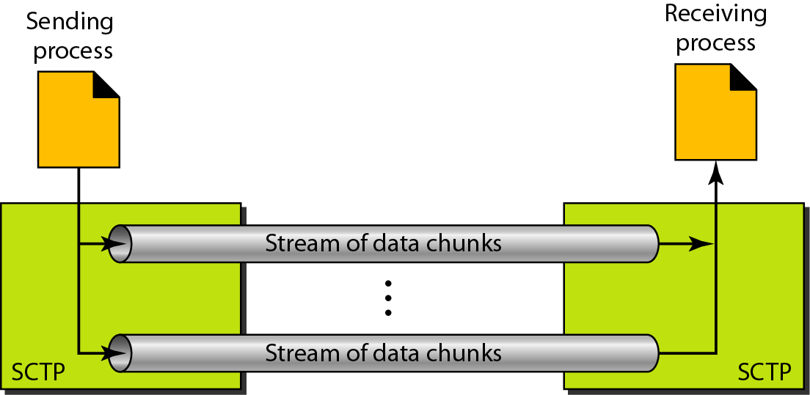
Why use SCTP
Fig: Multiple-stream Concept

Slide 7
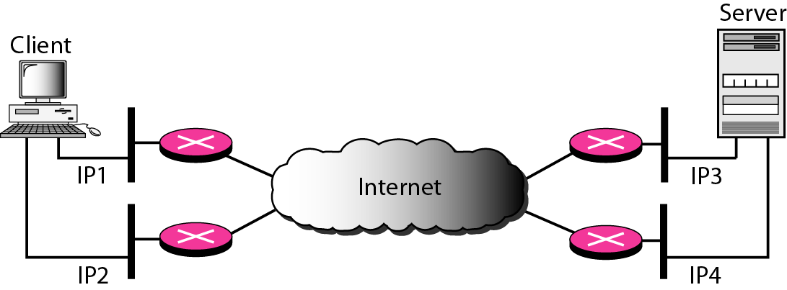
Why use SCTP
4.Multihoming:
An SCTP association,supports multihoming service. The sending and receiving host can define multiple IP addresses in each end for an association. In this fault-tolerant approach, when one path fails, another interface can be used for data delivery without interruption. This fault-tolerant feature is very helpful in Internet telephony.SCTP does not allow load sharing between different paths. Advantages of multihoming are
Improved Reliability,Load Balancing,Enhanced Network Resilience,Seamless Handovers.

Slide 8
Why use SCTP
5.Full-Duplex Communication:
Like TCP,SCTP offers full-duplex services,where data can flow in both directions at the same time.
6.Connection-Oriented Service:
Like TCP, SCTP is a connection-oriented protocol. However, in SCTP, a connection is called an association.
7.Reliable Service
SCTP, like TCP, is a reliable transport protocol. It uses an acknowledgment mechanism
to check the safe and sound arrival of data. We will discuss this feature further in the section on error control.

Slide 9
SCTP Features:
Chunk:
A chunk is the fundamental unit of data in an SCTP packet. SCTP is a message-based protocol, and each message from an application is encapsulated into one or more chunks.Data chunks (containing user data) or Control chunks ( controls and maintains the association containing signaling information like acknowledgments,stream reset requests)
Transmission Sequence Number (TSN):
SCTP uses a transmission sequence number (TSN) to number the data chunks.TSNs are 32 bits long and randomly initialized between 0 and 2^32 − 1. Each data chunk must carry the corresponding TSN in its header.
Note: In SCTP, a data chunk is numbered using a TSN.
Stream Identifier (SI):
In SCTP, there may be several streams in each association. Each stream in SCTP needs
to be identified using a stream identifier (SI). Each data chunk must carry the SI in its header so that when it arrives at the destination, it can be properly placed in its stream.
The SI is a 16-bit number starting from 0.
Note: To distinguish between different streams, SCTP uses an SI.
Stream Sequence Number (SSN):
To distinguish between different data chunks belonging to the same stream, SCTP uses SSNs.

Slide 10
Packets in SCTP :
Source Port Address(2 bytes) | Destination Port Address(2 bytes)
Verification Tag(4 bytes)
Checksum(4 bytes)
Control Chunk(variable length)
Data Chunk(variable length)
General
Header

Slide 11
Packets in SCTP :
An SCTP packet has a mandatory general header and a set of blocks called chunks. There are two types of chunks: control chunks and data chunks.
The general header (packet header) defines the end points of each association to which the packet belongs, guarantees that the packet belongs to a particular association, and preserves the integrity of the contents of the packet including the header itself.
Verification tag 32 bits Checksum 32 bits packet to an association. This prevents a packet from a previous association from being mistaken as a packet in this association. It serves as an unique identifier for the association; it is repeated in every packet during the association. It serves as a security and integrity checker and prevents attackers from injecting "stale" packets from old or spoofed connections.
The next field is a checksum. However, the size of the checksum is increased from 16 bits (in UDP, TCP, and IP) to 32 bits in SCTP to allow the use of the CRC-32 checksum.

Slide 12
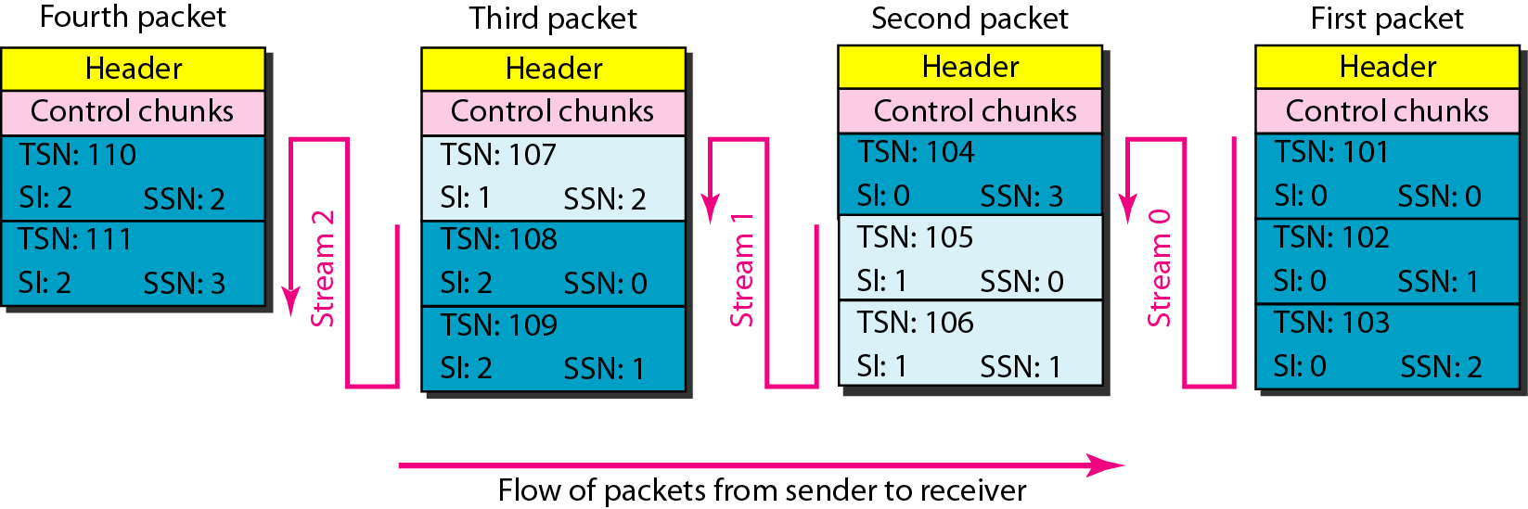
Fig: Packet, data chunks, and streams
‹#›

Slide 13
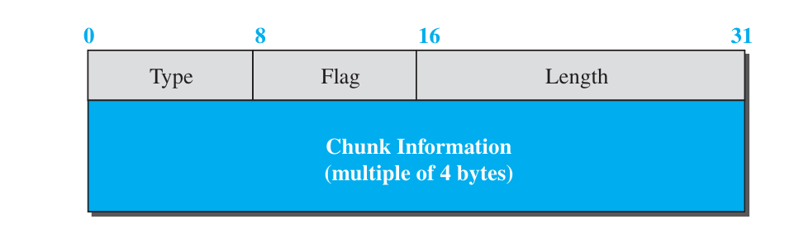
Chunks in SCTP :
Control information or user data are carried in chunks.
The information field depends on the type of chunk. The type field can define up to 256 types of chunks.
The flag field defines special flags that a particular chunk may need. Each bit has a different meaning depending on the type of chunk.
The length field defines the total size of the chunk, in bytes, including the type, flag, and length fields.
The size of the information section is dependent on the type of chunk, we need to define the chunk boundaries. If a chunk carries no information, the value of the length field is (4 bytes). This helps the receiver find out how many useful bytes a chunk carries.

Slide 14
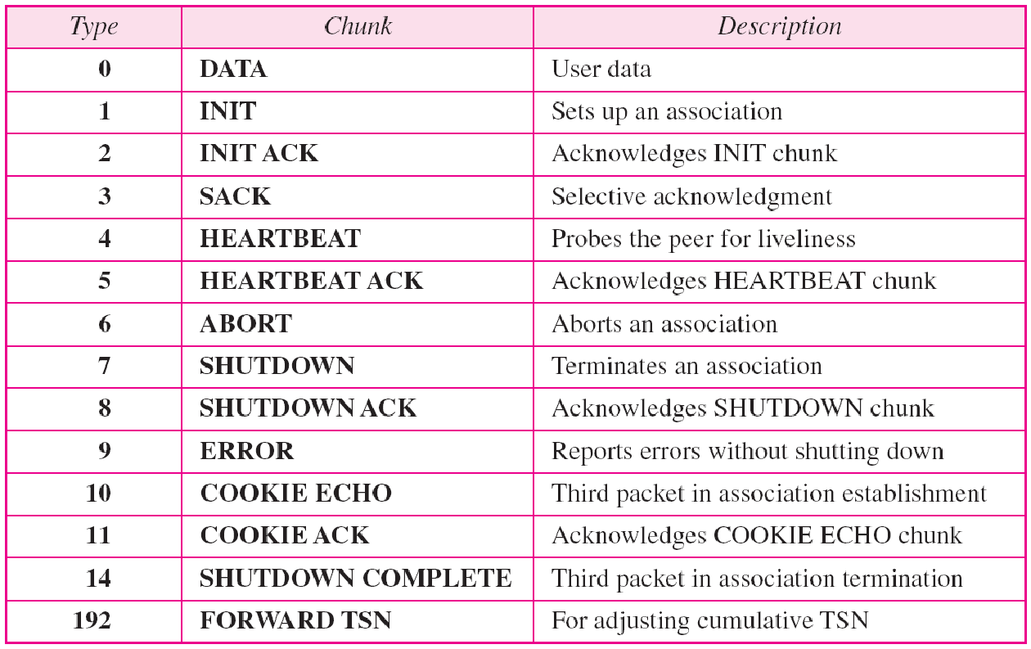
Various types of chunk

Slide 15
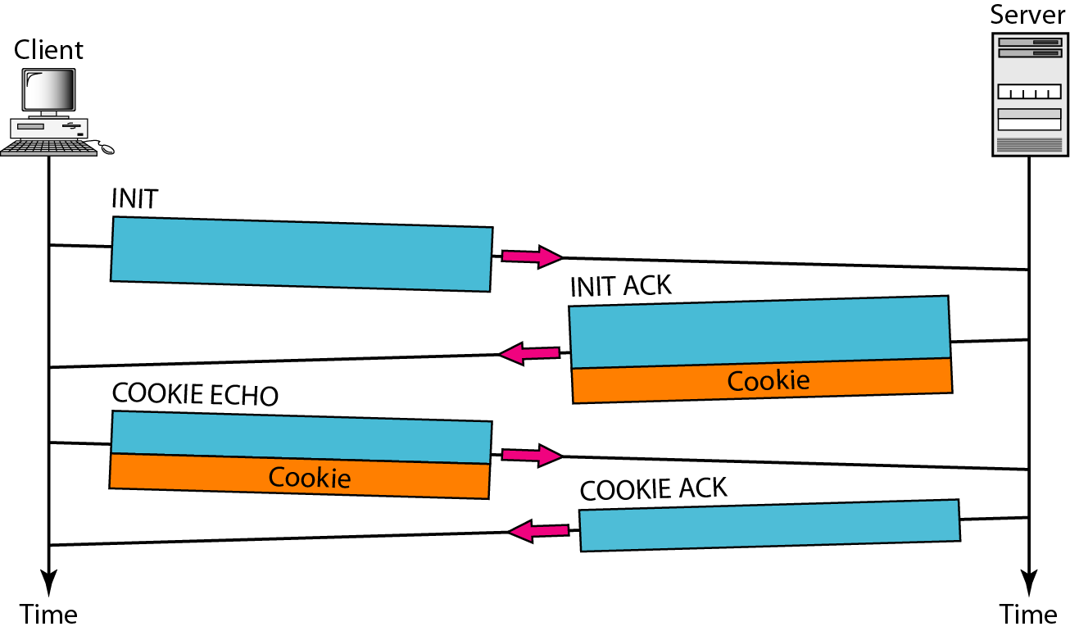
SCTP Association:
Association establishment in SCTP requires a four-way handshake.
In this procedure, a process, normally a client, wants to establish an association with another process, normally a server, using SCTP as the transport-layer protocol.
Similar to TCP, the SCTP server needs to be prepared to receive any association (passive open). Association establishment, however, is initiated by the client (active open).
the server generates and includes a cookie. This cookie is a stateful piece of information that encapsulates the server's current state and is sent back to the client. The server does not store the state of the new connection until it receives this cookie back, which helps protect against denial-of-service (DoS) attacks.

Slide 16
Four-way Handshaking
Step 1: Client Initiates (INIT Chunk)
The client, which wants to start the association, sends an INIT chunk to the server. Which contains:
Its list of IP addresses (for multihoming).
A verification tag (a random value to identify all subsequent packets from the client).
The initial transmit sequence number.
The number of streams the client wants to use.
Step 2: Server Responds with a Cookie (INIT-ACK Chunk)
Upon receiving the INIT chunk, the server does not immediately allocate resources. Instead, it generates a unique, cryptographically signed state cookie that contains all the information it needs to establish the association later, as well as a timestamp and a Message Authentication Code (MAC). The server sends this cookie back to the client inside an INIT-ACK chunk.
This chunk also includes the server's own list of IP addresses, a verification tag, Server’s Advertised Window (rwnd) and its initial transmit sequence number
Since the server doesn't allocate resources yet, it is protected from SYN flooding attacks where a malicious actor could overload a server with connection requests.

Slide 17
Four-way Handshaking
Step 3: Client Echoes the Cookie (COOKIE-ECHO Chunk)
The client receives the INIT-ACK and sends the server's state cookie back, untouched, inside a COOKIE-ECHO chunk. This acts as proof that the client received the server's response. The client can also begin sending user data within this chunk.
Step 4: Server Confirms and Establishes (COOKIE-ACK Chunk)
The server receives the COOKIE-ECHO chunk. It then verifies the integrity and authenticity of the cookie using its secret key and the timestamp. If the cookie is valid, the server finally allocates the necessary resources for the association, sends a COOKIE-ACK chunk to the client, and moves the association into the ESTABLISHED state.
This last message confirms that the association is officially ready for full data transfer. The COOKIE-ACK can also carry user data.

Slide 18
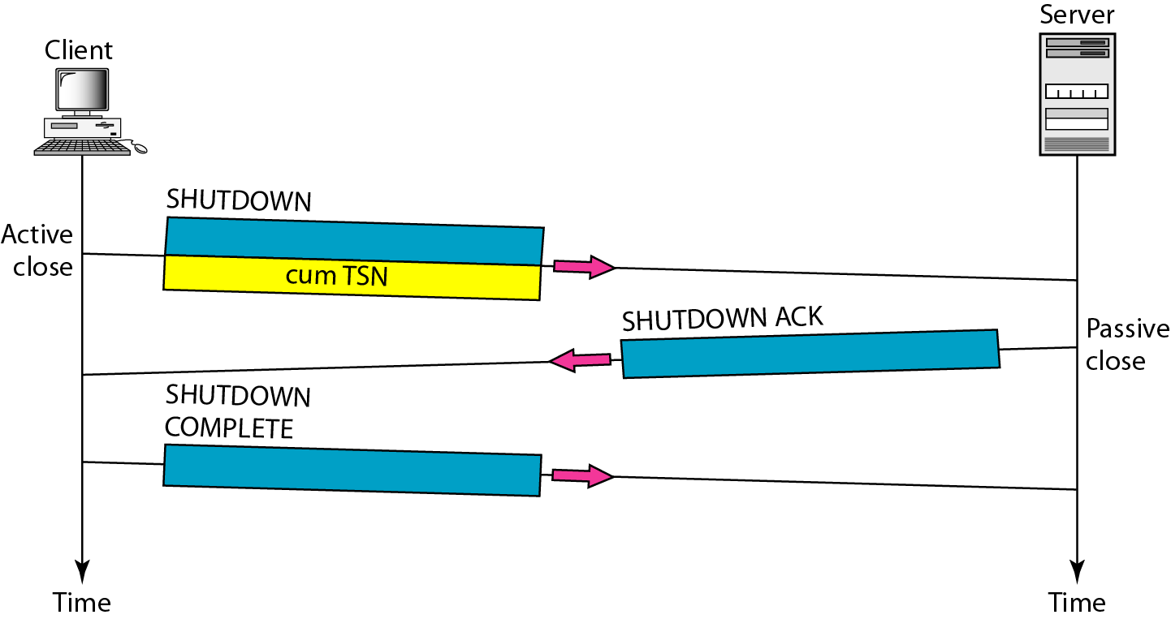
Fig: Association termination
‹#›

Slide 19
Flow Control in SCTP
The core of SCTP flow control is a credit-based system that uses these two windows:
Receiver Advertised Window (rwnd): This is a value, in bytes, that the receiver sends to the sender. It indicates how much free buffer space the receiver has available to accept incoming data. The rwnd prevents the sender from overwhelming the receiver's application buffer.
Congestion Window (cwnd): This is a value, also in bytes, maintained by the sender. It's the sender's estimate of the network's capacity. The cwnd prevents the sender from injecting more data into the network than it can handle, thus avoiding congestion.

Slide 20
Flow Control in SCTP
Sender's Limit: The sender can only transmit data up to the minimum of its cwnd and the rwnd advertised by the receiver. This ensures the sender is constrained by both the receiver's capacity and the network's capacity.
Data to send <= Min(cwnd, rwnd)
Sending Data: The sender transmits DATA chunks within this allowed window. Each chunk is assigned a Transmission Sequence Number (TSN). This is a global sequence number that is separate from the stream sequence numbers, and it is used for reliability and retransmission purposes across the entire association.
Receiver's Acknowledgment: The receiver uses a Selective Acknowledgment (SACK) chunk to report received data. This SACK chunk contains:
A cumulative TSN: The highest TSN received in a contiguous sequence.
Gap reports: A list of any out-of-order chunks that have been received.
An updated rwnd: The new available buffer space at the receiver.
Sender's Adjustment: When the sender receives a SACK, it uses the information to update its cwnd and rwnd variables.
If new data is acknowledged, the cwnd is increased (using algorithms like slow start or congestion avoidance).
The rwnd is updated with the value from the SACK, giving the sender a new credit for how much data it can send.

Slide 21
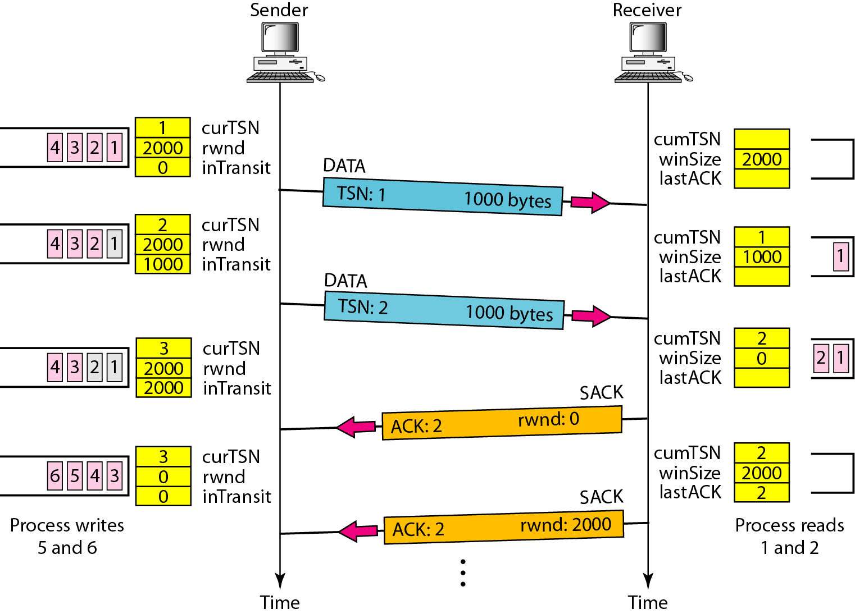
Fig: Flow control scenario

Slide 22
Error Control in SCTP
1. Checksum (CRC32c)
Ensures data integrity by detecting bit errors in packets.
2. Acknowledgment & Retransmission
Selective Acknowledgments (SACK) used instead of simple ACKs.
Missing chunks are retransmitted based on SACK feedback.
3. Sequence Numbers (TSNs)
Each data chunk is tagged with a Transmission Sequence Number for ordering and loss detection.
4. Timers
T3-rtx: Retransmits data after timeout.
Heartbeat Timer: Monitors path availability.

Slide 23
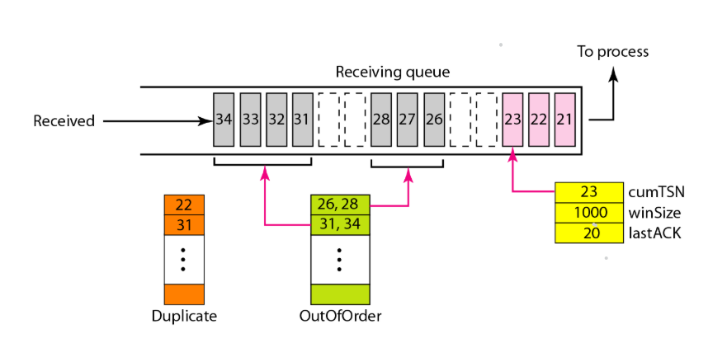
Fig: Error control at receiver side

Slide 24
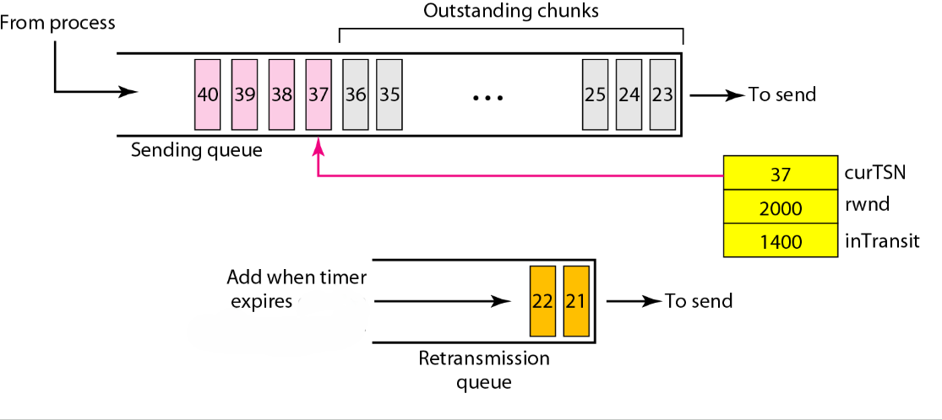
Fig: Error control, sender site

Slide 25
SCTP Applications
Telecommunications and Mobile Networks
Originally designed for SS7 message transport over IP.
Handles critical signaling and control messages for 3G, 4G, and 5G networks (e.g., call setup, roaming, subscriber management).
Real-Time and Mission-Critical Applications
Reliable and low-latency transport for applications where timely delivery matters.
Financial services: Multistreaming prevents head-of-line blocking, allowing independent handling of market data and trading confirmations.
WebRTC: Used as a data channel for peer-to-peer file sharing, multiplayer games, and real-time communication, supporting multiple independent data streams.
General-Purpose Applications
Load balancing & security: Multihoming aids fault tolerance; the cookie-based handshake resists SYN flood attacks.
Message-oriented applications: Preserves message boundaries, simplifying programming for message-based protocols like industrial automation or database sync.

Slide 26
SCTP shortcomings
Complexity
More complex than TCP or UDP due to features like multistreaming, multihoming, and chunk-based data delivery.
Implementation and debugging can be harder for developers.
Firewall and NAT Traversal Issues
Some networks may block SCTP packets because it’s less common.
NAT traversal is not as straightforward as with TCP/UDP.
Limited Tooling and Libraries
Fewer libraries, frameworks, and monitoring tools exist compared to TCP/UDP, making development and maintenance more difficult.
Not Ideal for All Applications
Applications that don’t need multistreaming or multihoming may not benefit from SCTP’s features, making TCP a simpler choice.

Slide 27
Thank you

